Slide 1
The Product Recommendation for H&M
Course: BIA 679
Instructor: Dr. Mohammad Nikouei

Slide 2


Slide 3
Project Introduction
Goal: Provide product recommendations based on customer purchase intentions for clothing or shopping sites
Describe: Predict consumer purchases with a dataset of consumer purchase records published on Kaggle by H&M. Models can provide companies with products that consumers are likely to buy. Therefore, online shopping platforms can provide recommendations to consumers based on the results of the model
Software: Spark

Slide 4
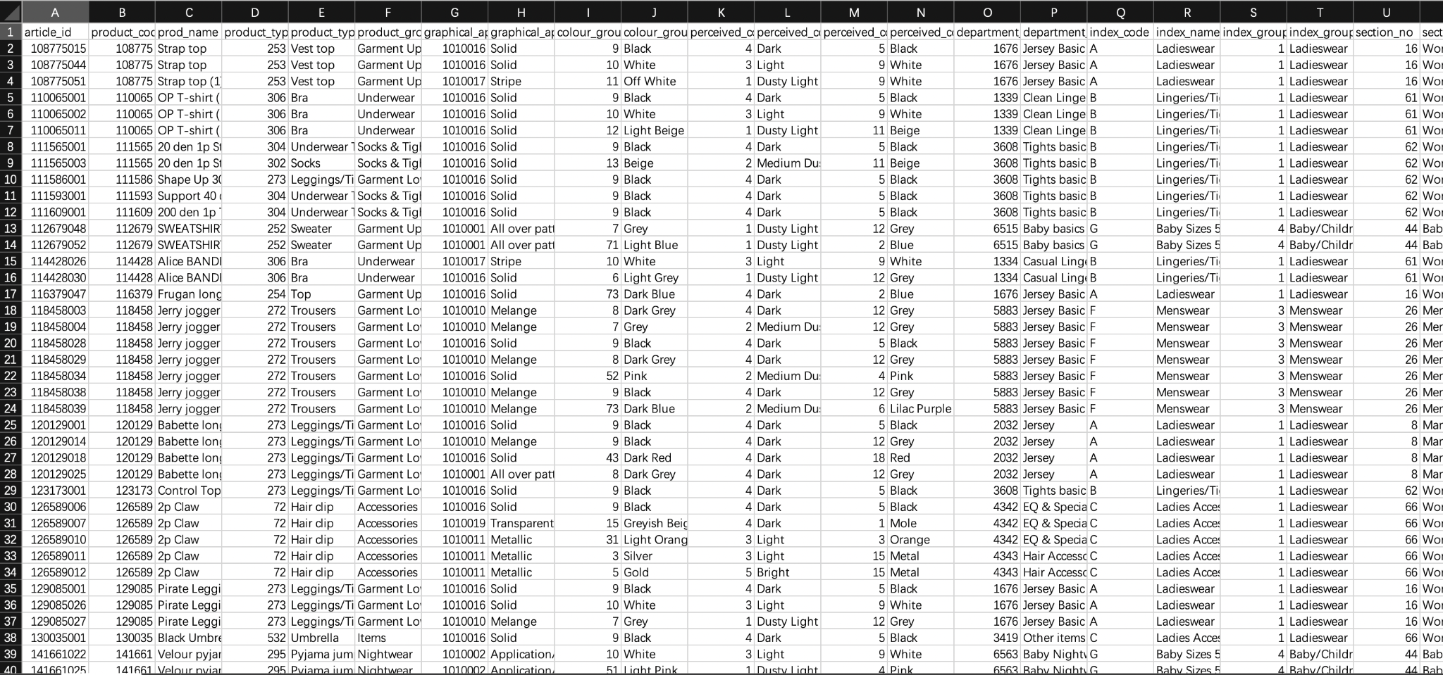
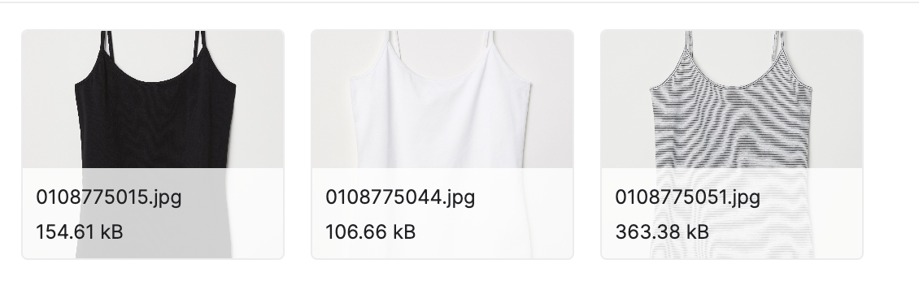
Project Introduction
Dataset: https://www.kaggle.com/competitions/h-and-m-personalized-fashion-recommendations/data

Slide 5
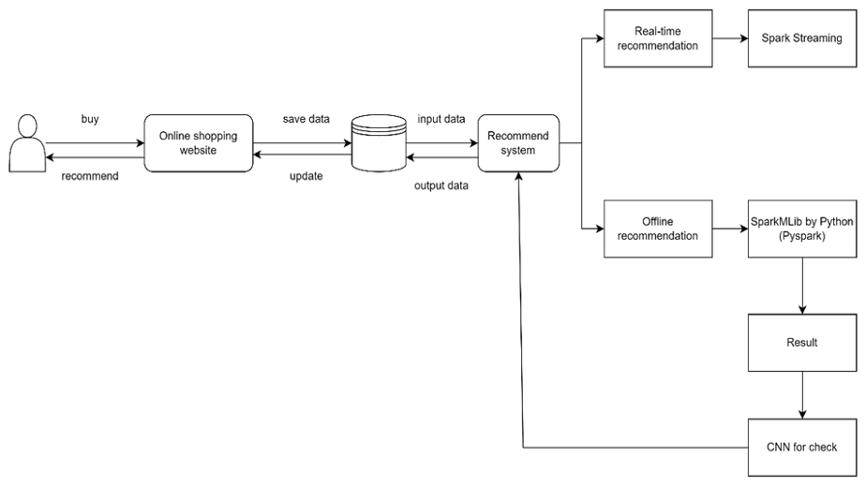
Model design

Slide 6
Collecting & Understanding Data
Data Intro | Amount | Size
Columns of Articles | 23 variables | 36.14MB
Columns of Customer | 7 variables | 207.14MB
Image | 105k | 28G

Slide 7
Columns | Feature
customer_id | The customer id
Active | Active or not active
club_member_status | The status of club member
fashion_news_frequency | The frequency of fashion news
age | The customer age
postal_code | The customer’s postal code
Columns | Feature
article_id | The article id
product_code | The code of product
prod_name | The name of product
product_type_no | The number of product type
… | …
Simple Columns of articles
Simple Columns of customer

Slide 8
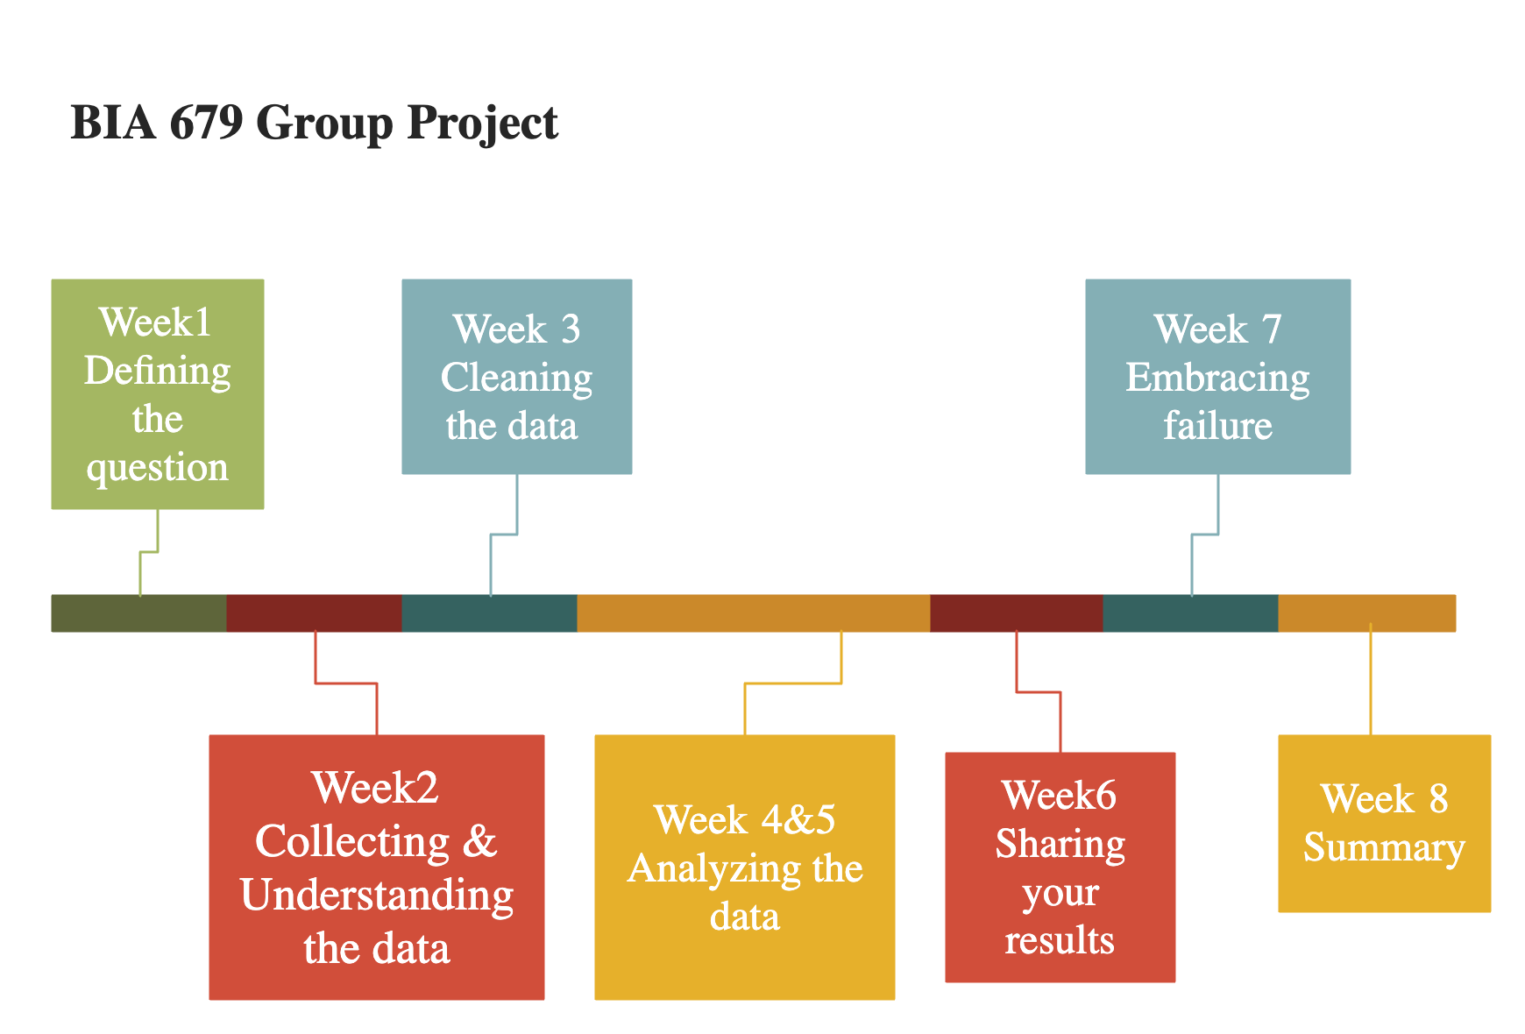

Slide 9
What’s New?
Exploratory Data Analysis (EDA)
Statistics on product filter by time, amount, etc
Statistics on customer filter by id, age, etc
Transaction amount by date
Correlation between customer and product
Word Cloud

Slide 10
What’s Next?
Environment Set-up:
Apache Spark load in
Select data for recommendation
Model building:
Training data & Test data
Build the ALS model and fit in the data

Slide 11
EDA
https://github.com/tychen17/The-Product-Recommendation-for-H-M/blob/main/EDA.ipynb
Word Cloud Description
https://github.com/tychen17/The-Product-Recommendation-for-H-M/blob/main/Word%20Cloud%20for%20Description.ipynb

Slide 12
Reference
Zhao, Xuesong. “A Study on e-Commerce Recommender System Based on Big Data.” 2019 IEEE 4th International Conference on Cloud Computing and Big Data Analysis (ICCCBDA), 2019, https://doi.org/10.1109/icccbda.2019.8725694.
Jessica Young | Feb 18, 2022, et al. “US Ecommerce Grows 14.2% in 2021.” Digital Commerce 360, 16 Sept. 2022, https://www.digitalcommerce360.com/article/us-ecommerce-sales/.
“H&M Personalized Fashion Recommendations.” Kaggle, https://www.kaggle.com/competitions/h-and-m-personalized-fashion-recommendations/data.

Slide 13
Thank you

